Slide 1
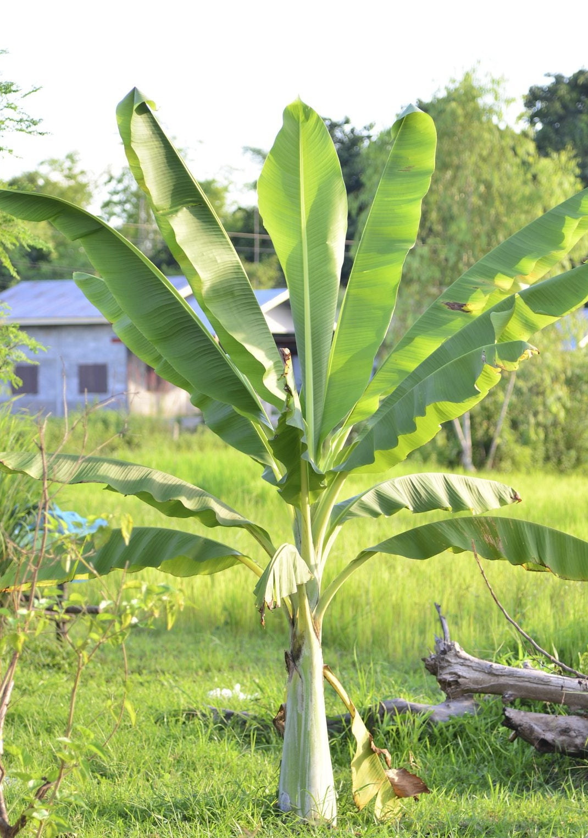
Banana Plant Diseases
Dhruv Joshi

Slide 2
Why we need this ?
Food Security: Early detection of banana plant diseases ensures stable crop yields, supporting global food supply.
Economic Stability: Prevents significant financial losses for farmers and exporters in regions reliant on banana production.
Disease Control: Helps in managing and containing the spread of highly infectious banana diseases.
Sustainable Practices: Enables targeted use of pesticides, reducing environmental impact and production costs.
Quality Assurance: Maintains the quality and quantity of produce, ensuring market readiness and consumer satisfaction.

Slide 3
Agenda
Introduction
Database
Preprocessing
resnet101
training and testing
Fine-tuning

Slide 4
Introduction
Focuses on the core function and benefit

Slide 5
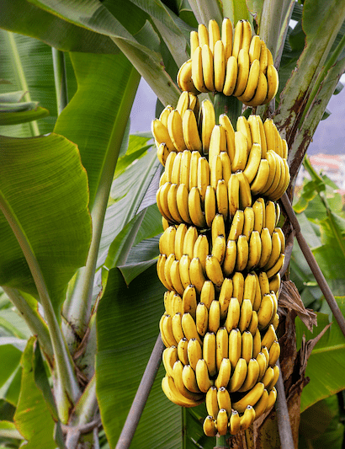
Introduction
Banana cultivation is a vital part of the global agricultural sector, and diseases like Cordana, Sigatoka, and Pestalotiopsis can significantly impact yield and profitability.
Our aim is to develop a system that can accurately detect and classify these diseases using deep learning techniques. This system has the potential to revolutionize the way farmers manage banana crops, allowing for early disease detection and reducing crop losses.

Slide 6
Introduction
In this presentation, we will explore:
The dataset and its characteristics.
The deep learning model architecture we used.
The results and evaluation of the model’s performance.
Future directions and the potential impact of this technology.
I hope you find this presentation informative and engaging. Let's dive in!

Slide 7
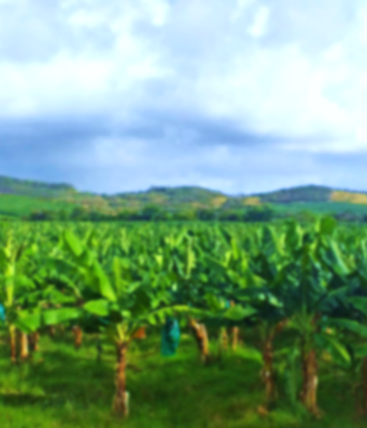
Database

Slide 8
Database (link)
A database, in this context, is a collection of image data organized into folders representing different categories of banana leaf diseases. It includes images of banana leaves affected by Cordana, healthy leaves, leaves with Pestalotiopsis, and leaves with Sigatoka. This database is used for training and testing a deep learning model to classify and predict diseases based on the visual features of the leaves. The dataset is divided into training and testing sets for ensuring the model's generalization capabilities, allowing for accurate predictions on new, unseen images.

Slide 9
Preprocessing
Highlights the innovative aspect and positive impact

Slide 10
Preprocessing
Normalization
Label Encoding
5
4
3
2
1
Data Augmentation
Standardization
Convert to Tensor

Slide 11
Preprocessing
Preprocessing in the context of machine learning involves transforming raw data into a format suitable for model training. This encompasses tasks such as normalization (scaling pixel values to a specific range), data augmentation (generating variations of existing images to increase training data and model robustness), encoding categorical labels (converting string labels into numerical representations), and standardization (transforming data to have zero mean and unit variance). These steps ensure consistent input formats for the model, enhancing its ability to learn meaningful patterns and achieve better performance on unseen data.

Slide 12

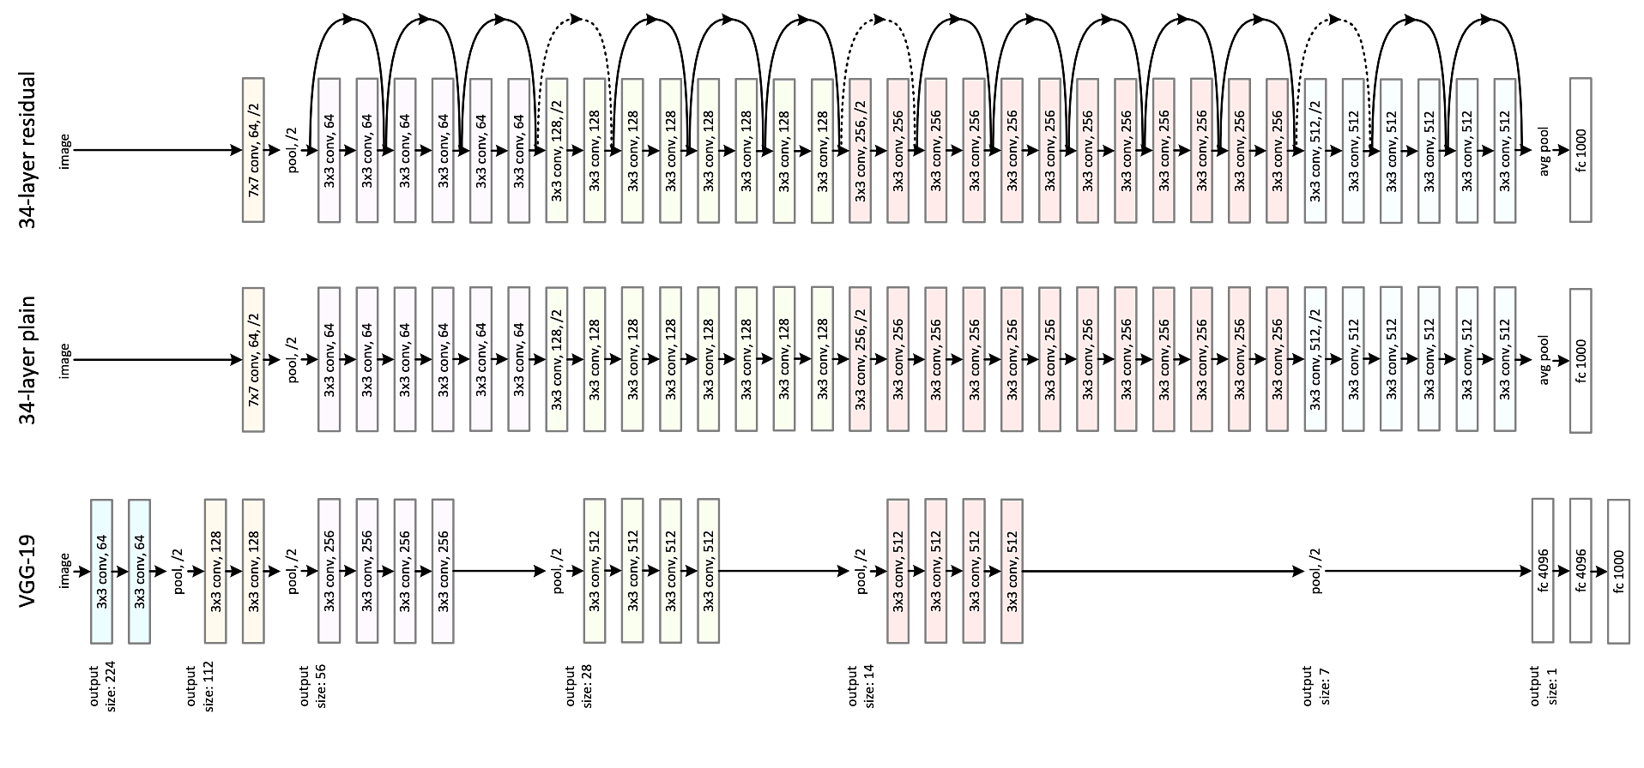
ResNet-101

Slide 13
ResNet-101
ResNet101 is a deep convolutional neural network architecture that excels in image classification tasks. It utilizes a residual learning framework, where layers learn to map residual functions rather than directly learning the underlying mapping. This allows for training significantly deeper networks, leading to improved accuracy in image recognition and analysis. In this code, ResNet101 is adapted and used for classifying banana plant diseases.

Slide 14
Training and Testing
Focuses on the potential of the technology

Slide 15
Model Training
The provided code defines a deep learning model for classifying banana plant diseases using a pre-trained ResNet101 convolutional neural network. It loads and preprocesses images of banana plants with different diseases, trains the model on these images using transfer learning, and fine-tunes the model for improved accuracy. The model is then evaluated on a test dataset and its performance is assessed through accuracy and loss metrics, along with visualization of its training progress and predictions on sample images. Finally, the trained model is saved for future use.

Slide 16
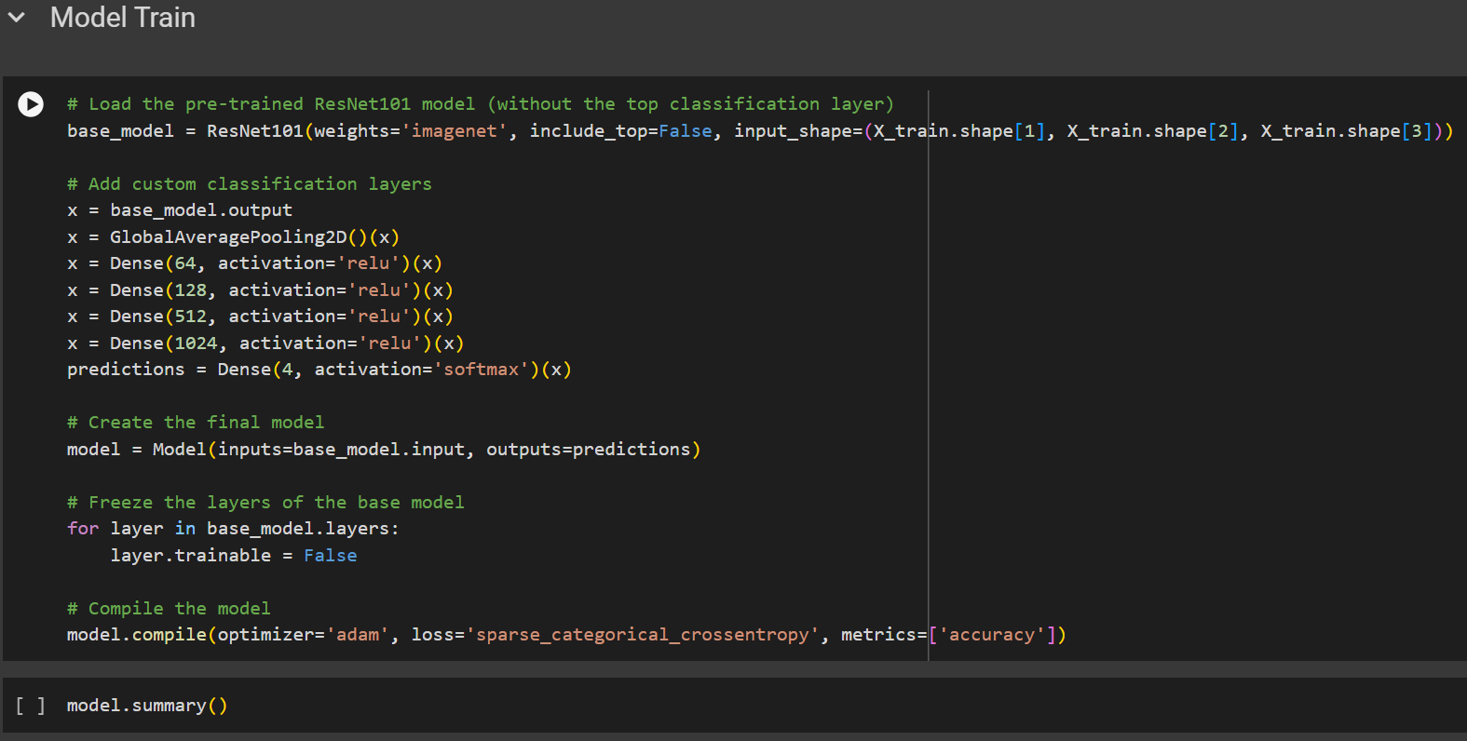

Slide 17
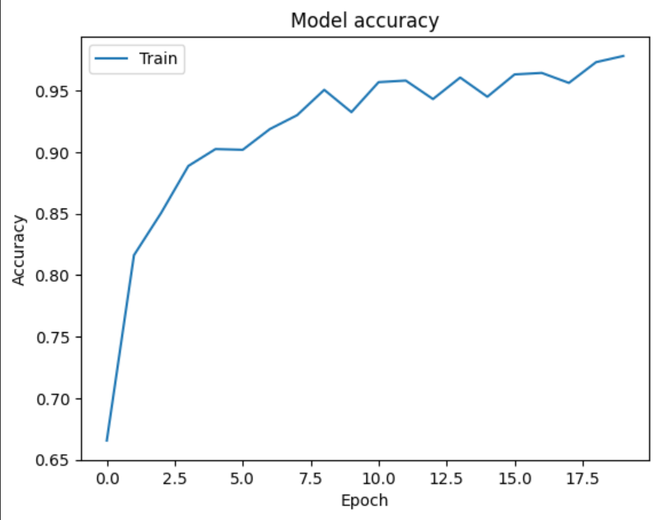
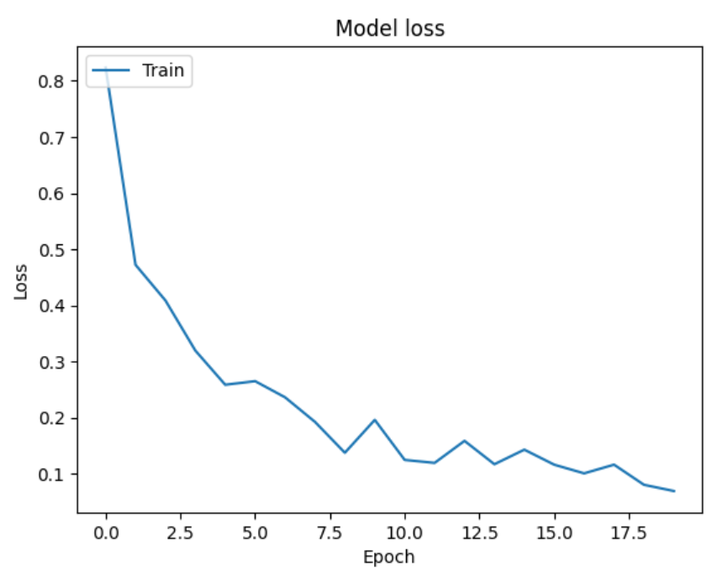

Slide 18
Model Testing
Model testing involves evaluating a trained machine learning model's performance on a separate dataset (the test set) that was not used during training. This helps assess how well the model generalizes to unseen data and provides insights into its accuracy, precision, and other relevant metrics, ultimately determining its effectiveness in real-world scenarios.

Slide 19
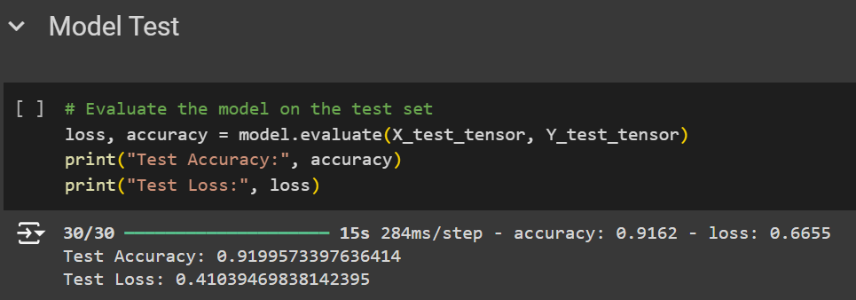

Slide 20
Fine-Tuning
Emphasizes innovation and technology

Slide 21
Fine-Tuning
Fine-tuning is a technique where you take a pre-trained model (like ResNet101 trained on ImageNet) and further train it on a new, specific dataset with a smaller learning rate. This allows the model to adapt its learned features to the new dataset while preserving the valuable knowledge it gained during its initial training, leading to better performance for the target task, especially when the new dataset is limited in size.

Slide 22
Eschatology
In essence, this project demonstrates a standard workflow for image classification using transfer learning and deep learning techniques.
It effectively tackles the problem of banana plant disease identification, which is crucial for agricultural management and yield optimization.

Slide 23
Thank you
Dhruv Joshi | LinkedIn
Dhruv Joshi | GitHub

